Slide 1
6. Python Data Science Toolbox (Part 1)

Slide 2
Course Description
It's time to push forward and develop your Python chops even further. There are tons of fantastic functions in Python and its library ecosystem. However, as a data scientist, you'll constantly need to write your own functions to solve problems that are dictated by your data. You will learn the art of function writing in this first Python Data Science Toolbox course. You'll come out of this course being able to write your very own custom functions, complete with multiple parameters and multiple return values, along with default arguments and variable-length arguments. You'll gain insight into scoping in Python and be able to write lambda functions and handle errors in your function writing practice. And you'll wrap up each chapter by using your new skills to write functions that analyze Twitter DataFrames.
1

Slide 3
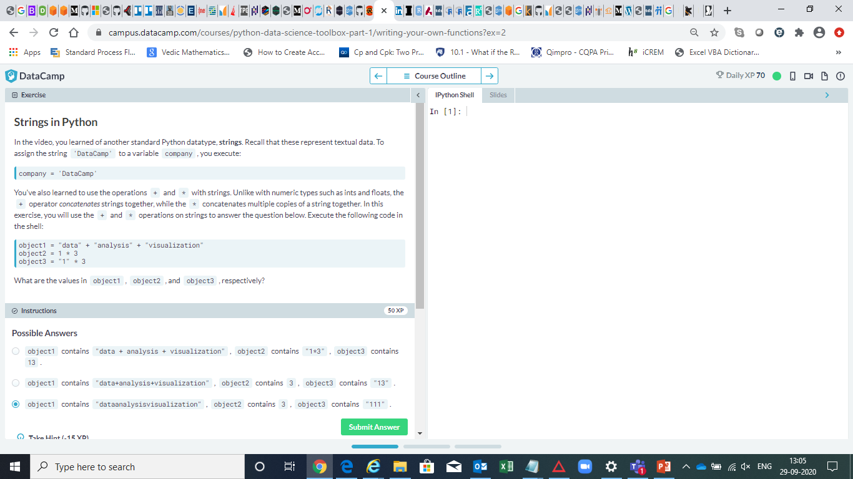

Slide 4
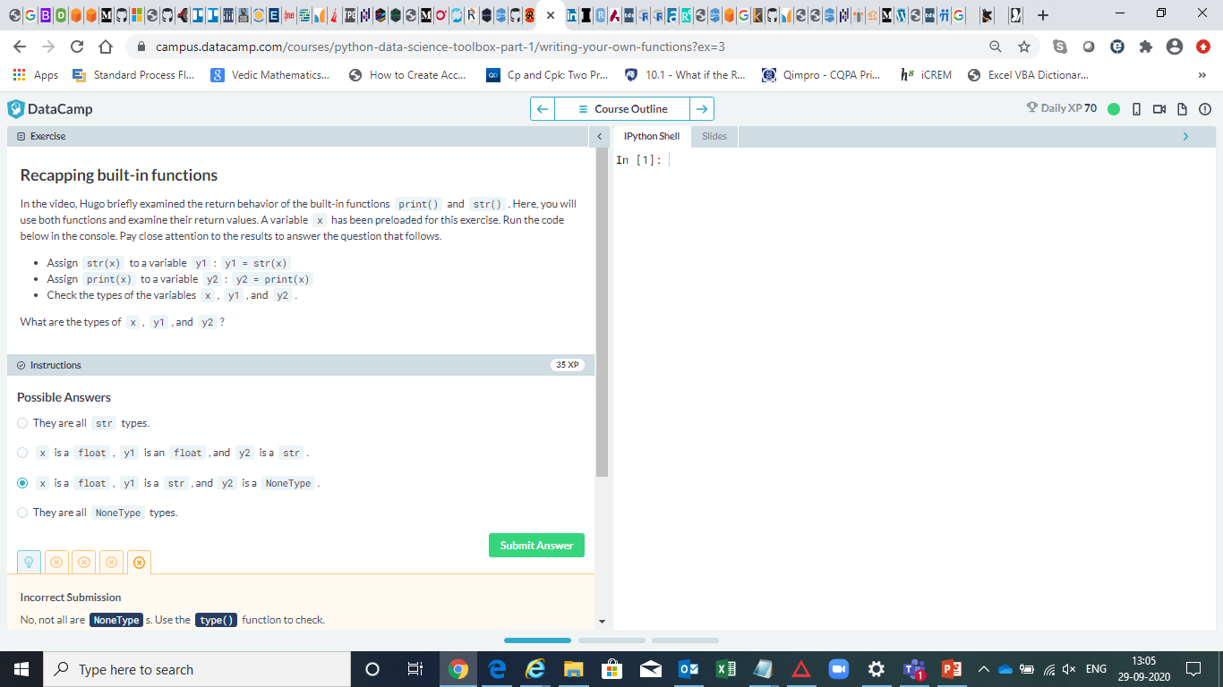

Slide 5
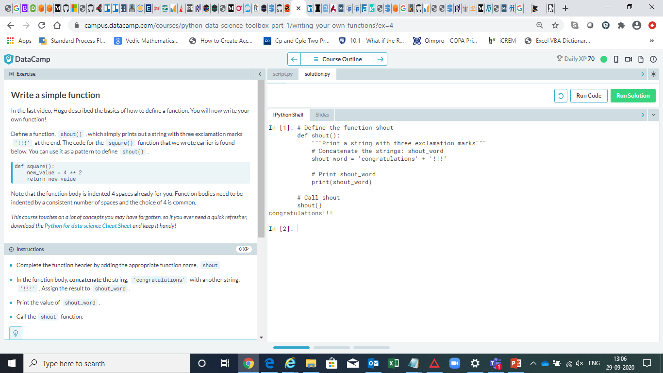

Slide 6
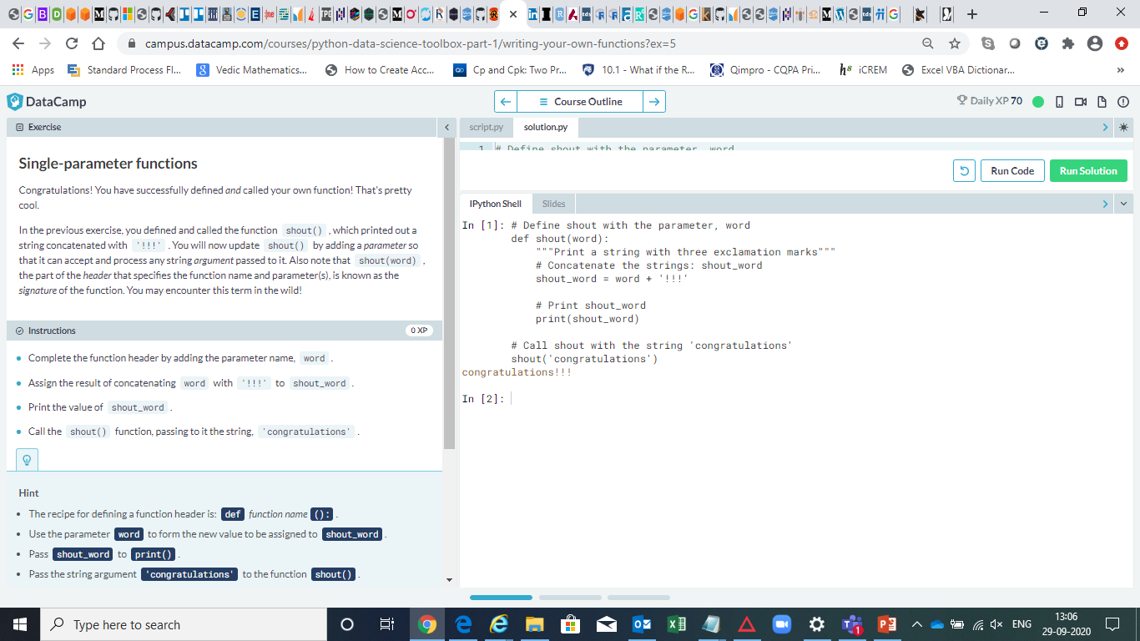

Slide 7
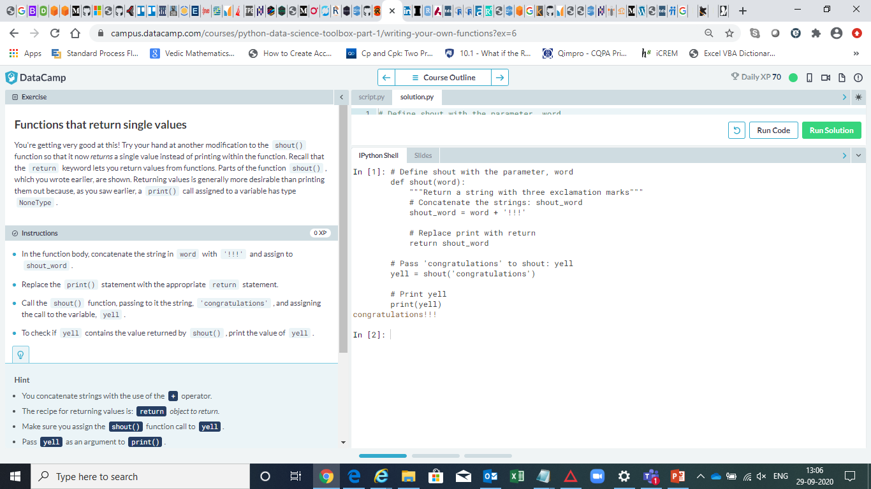

Slide 8
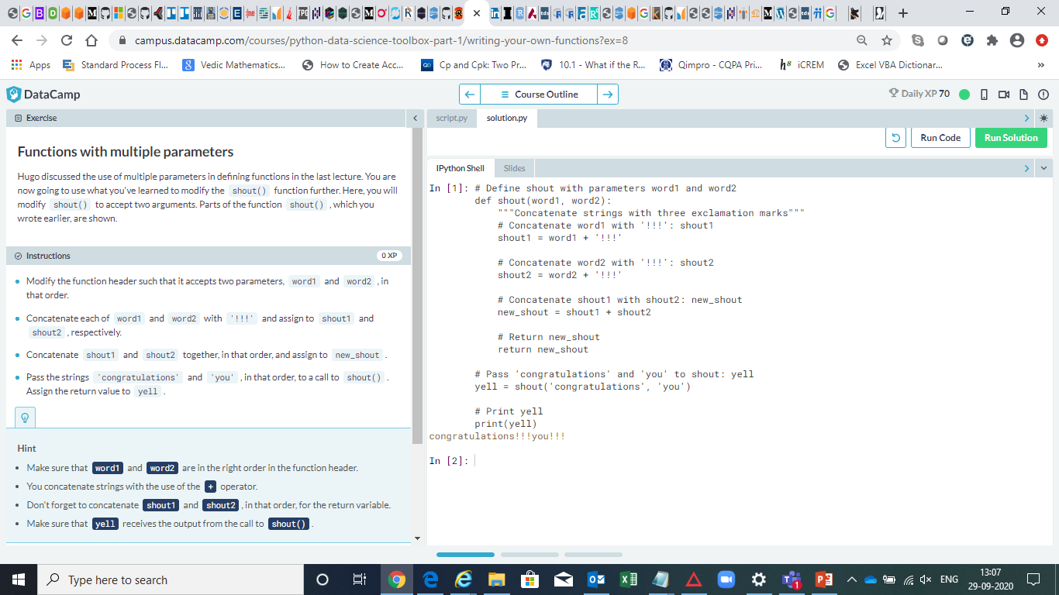

Slide 9
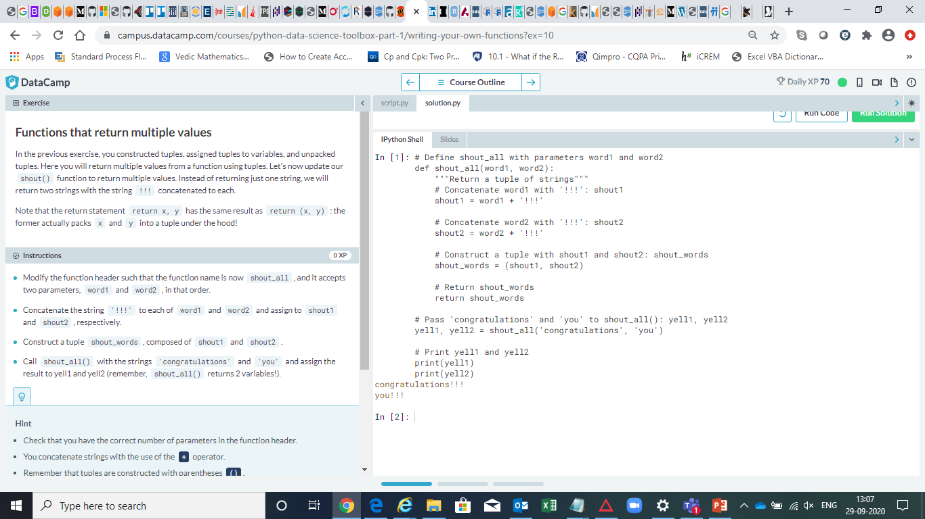

Slide 10
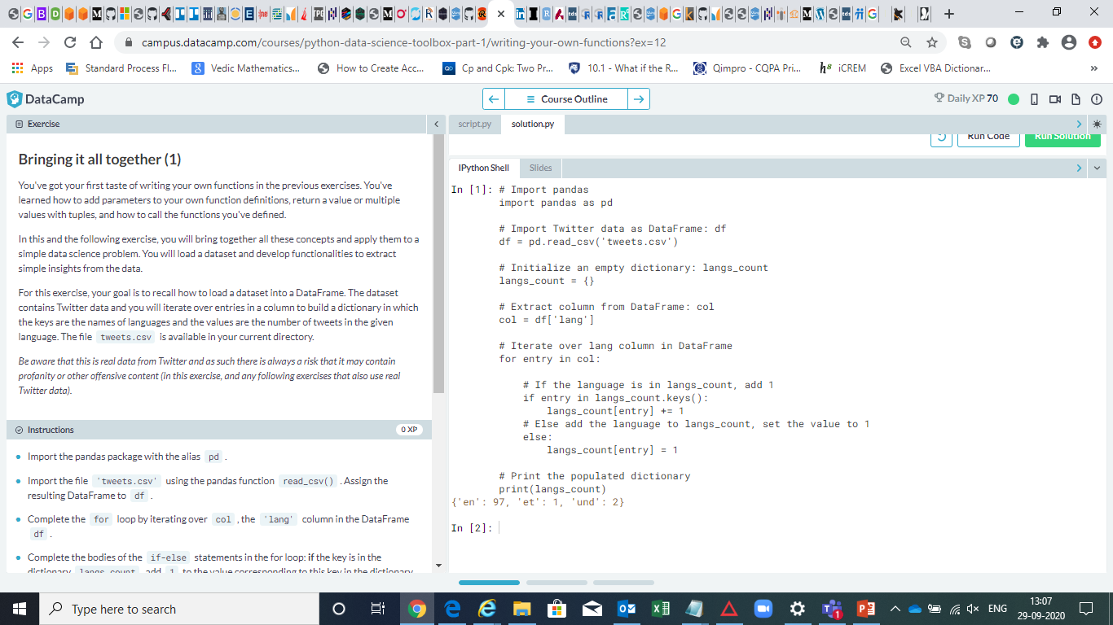

Slide 11
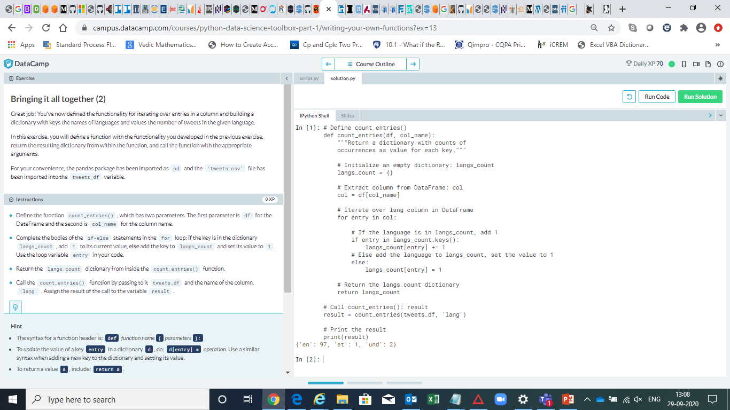

Slide 12
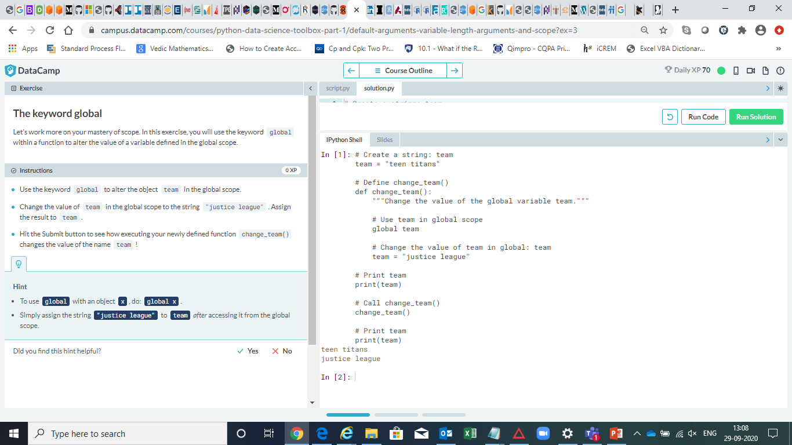

Slide 13
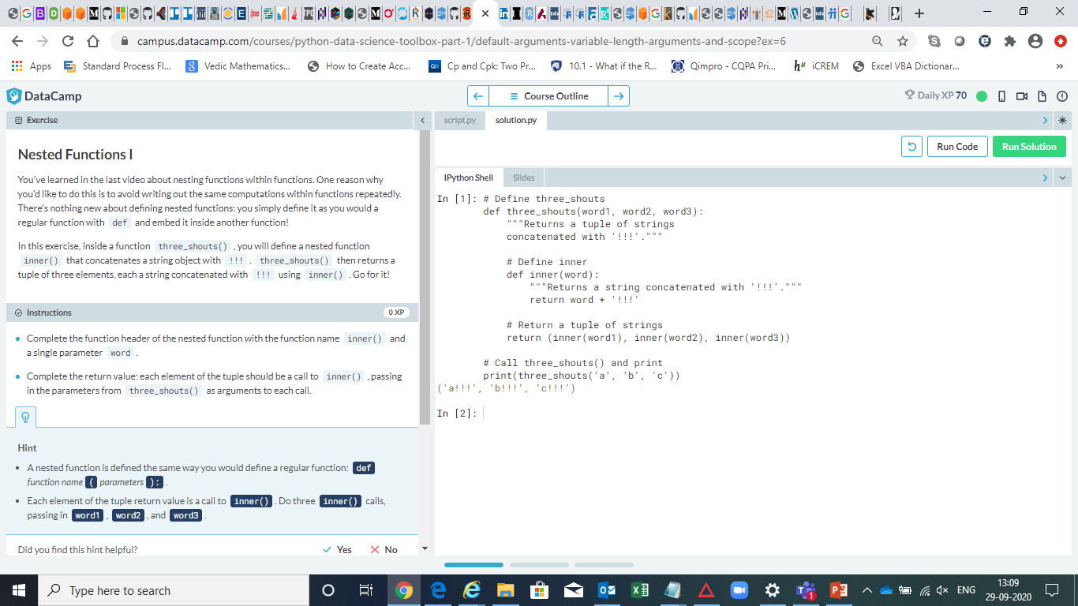

Slide 14


Slide 15
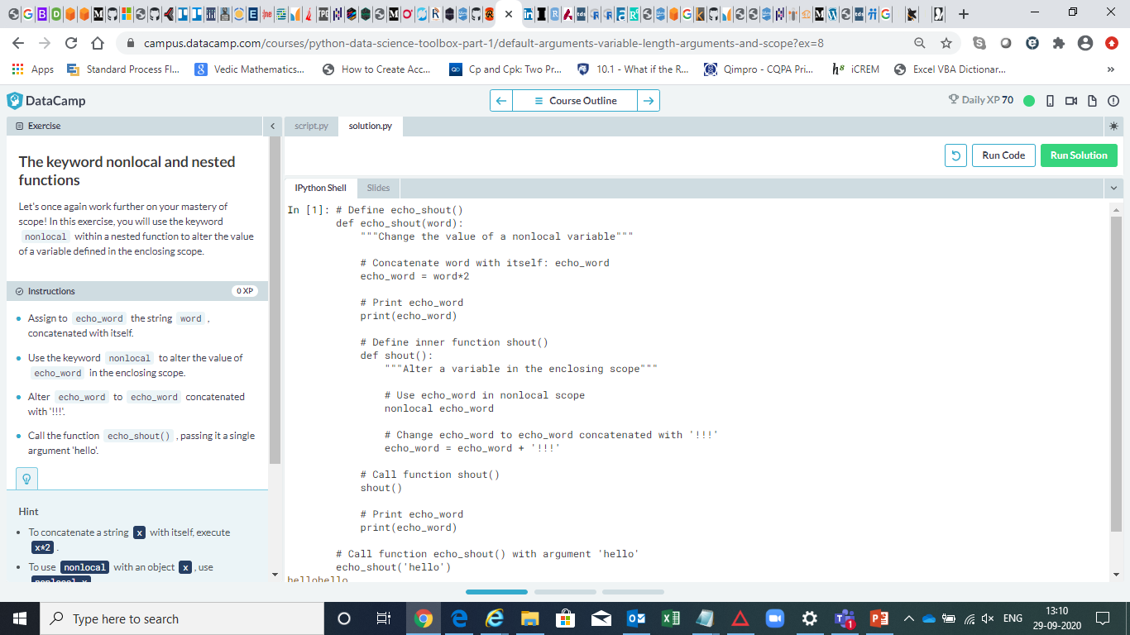

Slide 16
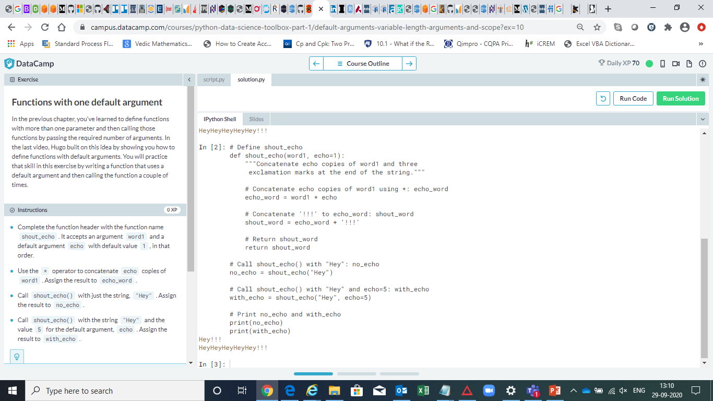

Slide 17
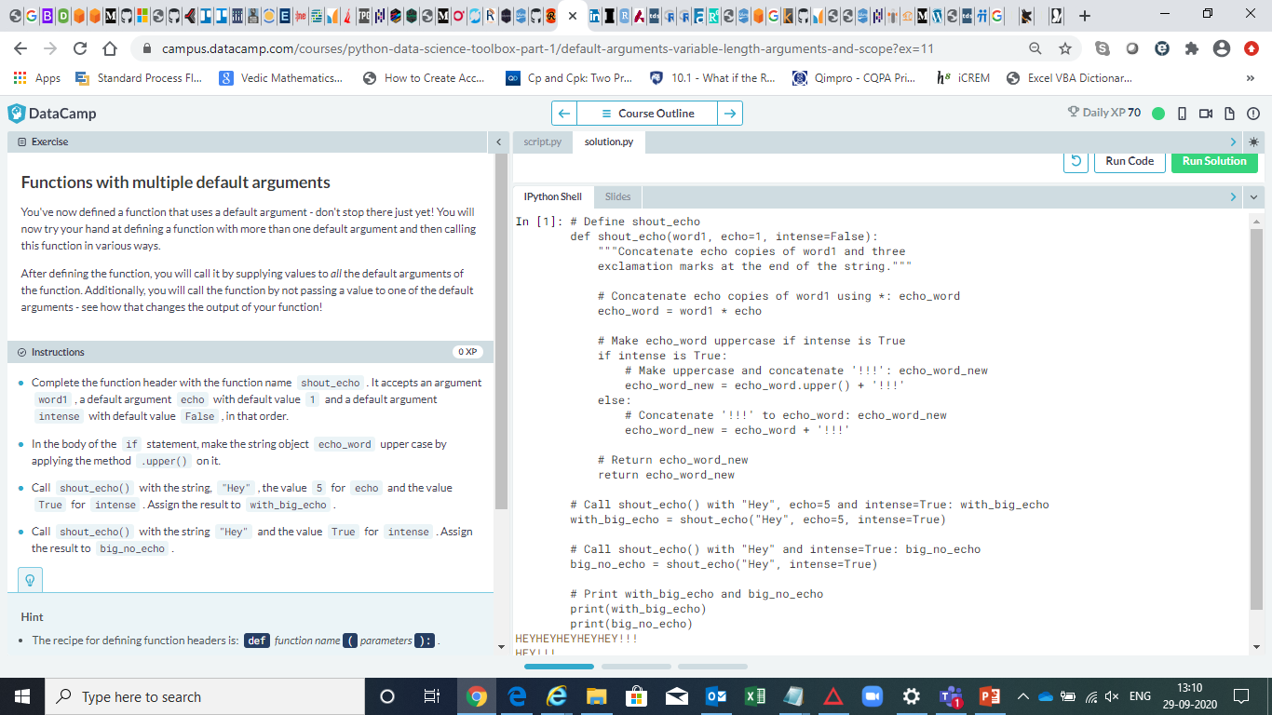

Slide 18
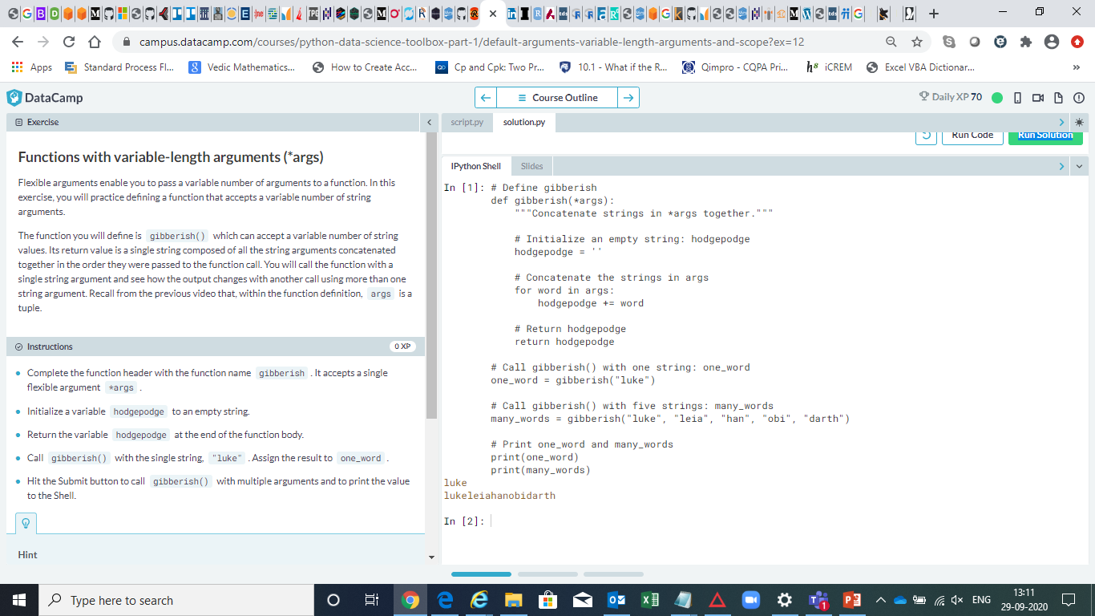

Slide 19
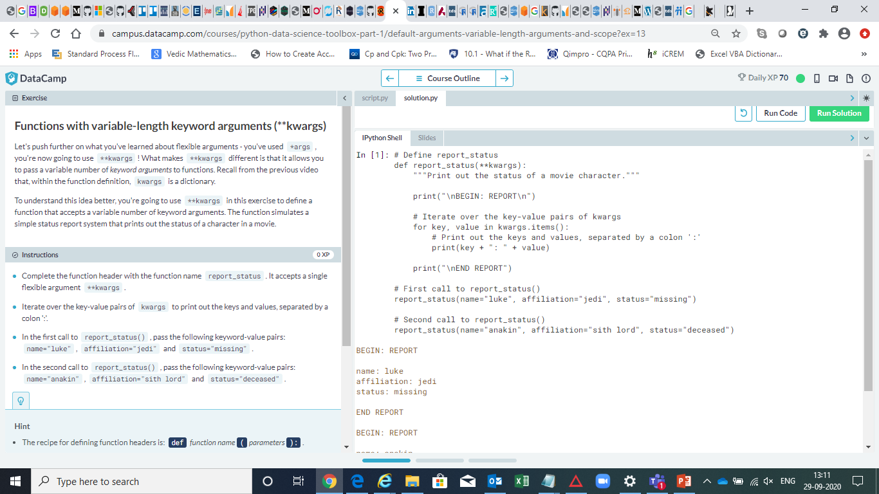

Slide 20
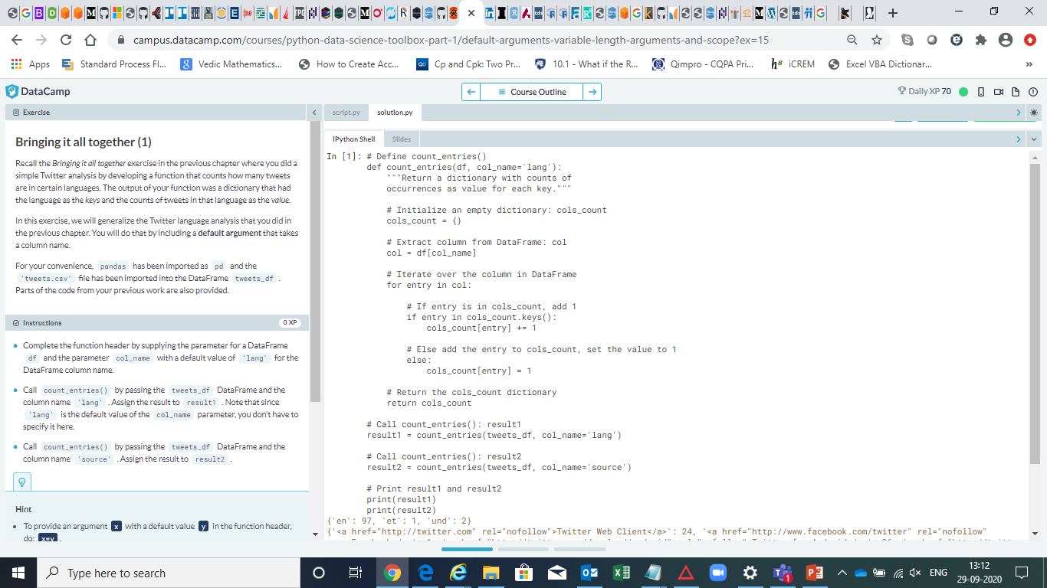

Slide 21
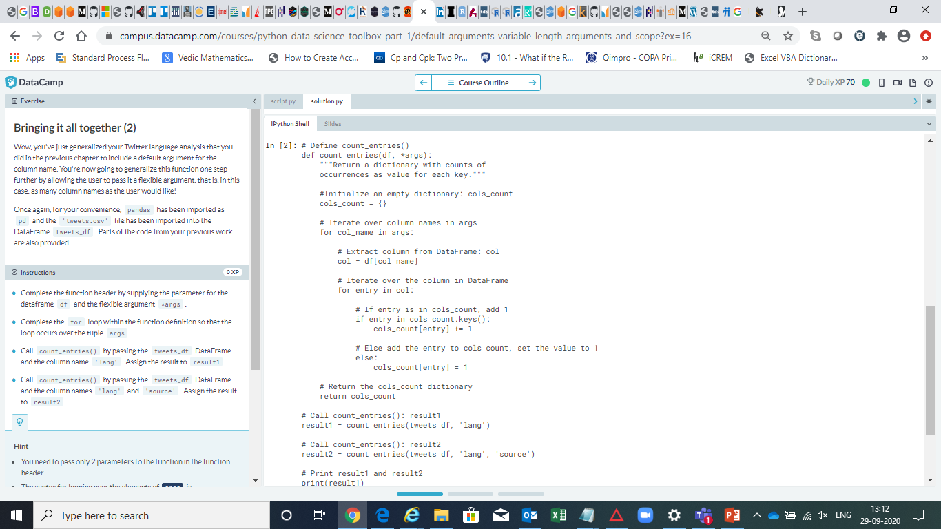

Slide 22
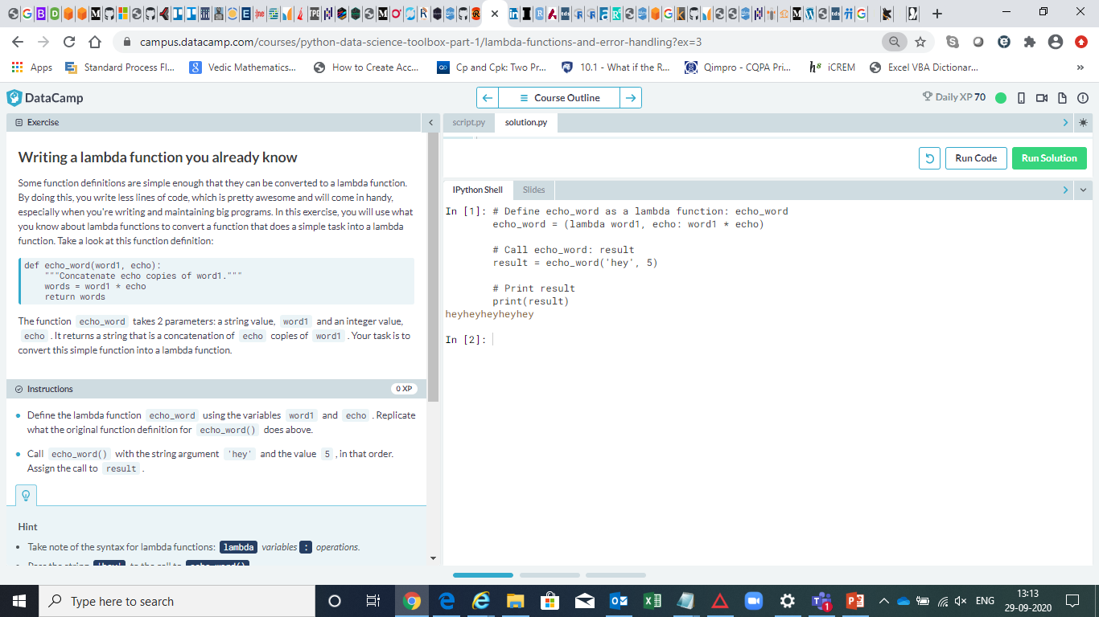

Slide 23
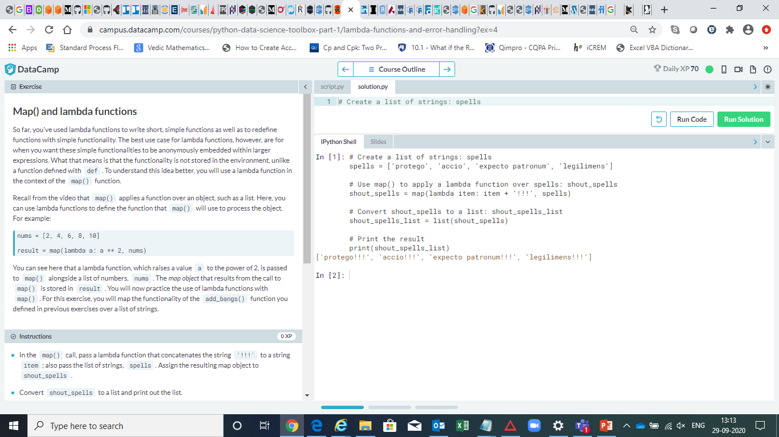

Slide 24
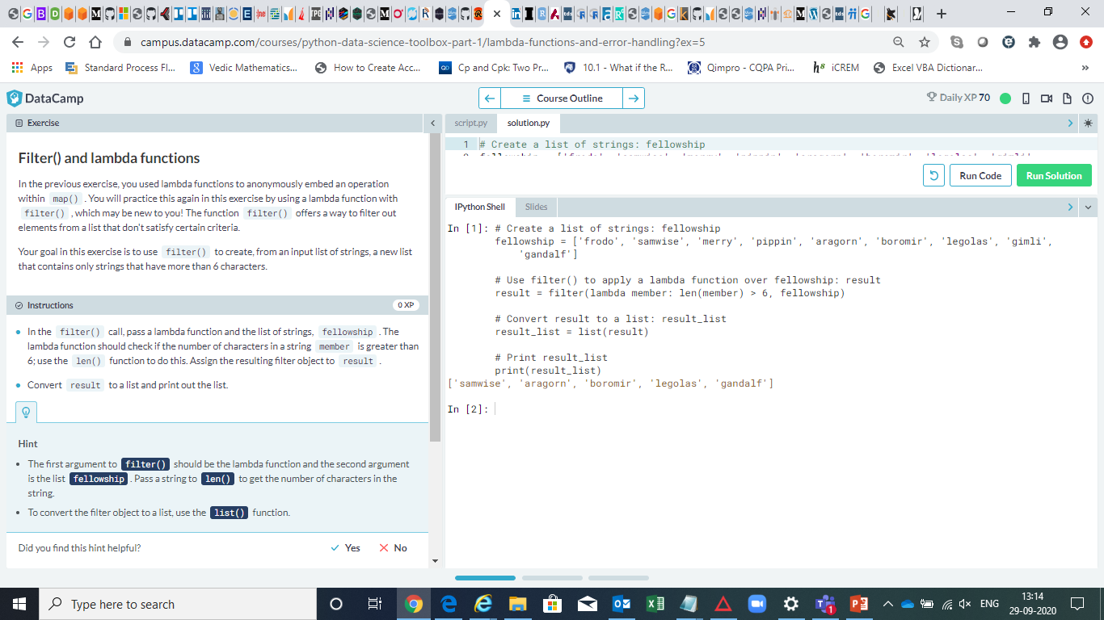

Slide 25


Slide 26


Slide 27
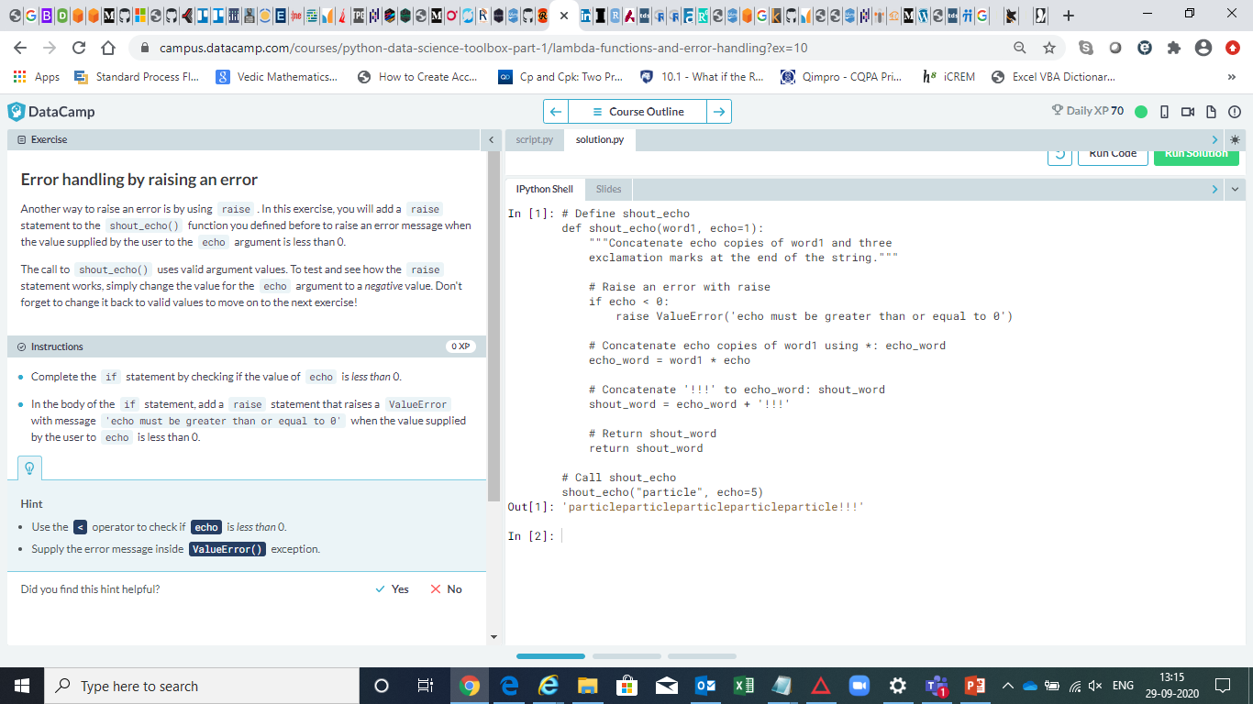

Slide 28
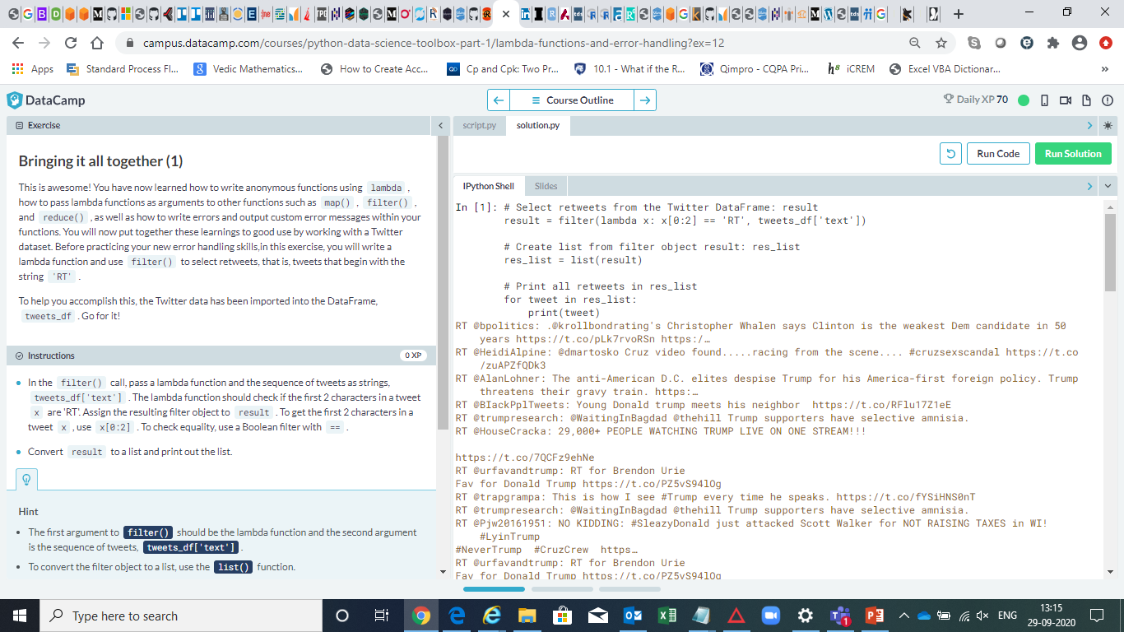

Slide 29
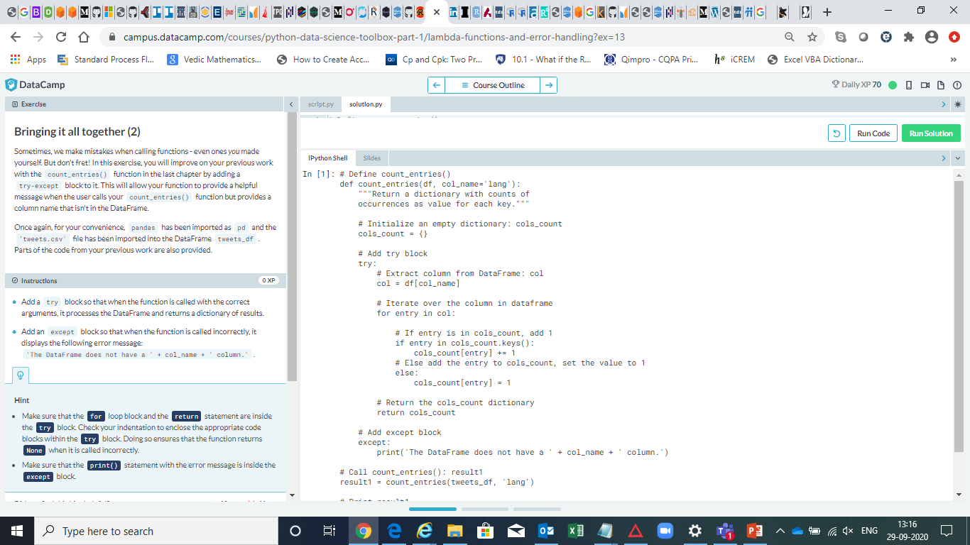

Slide 30
